Slide 1


Your one-stop platform for all your rental needs
Chan Ming Han
Crystal Cheong
Ng Mu Rong
Cheong Chi Hian
Ang Jun Koon

Slide 2
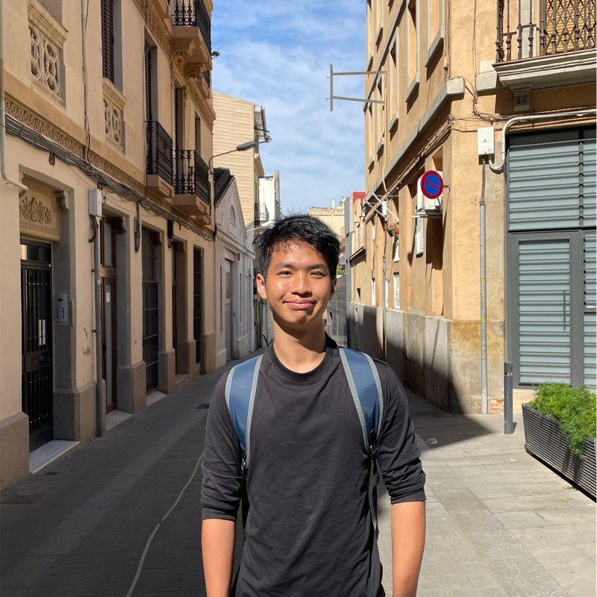


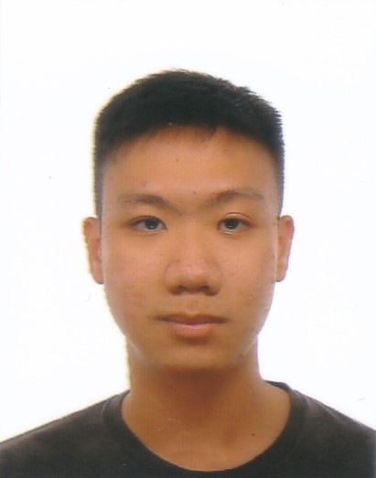
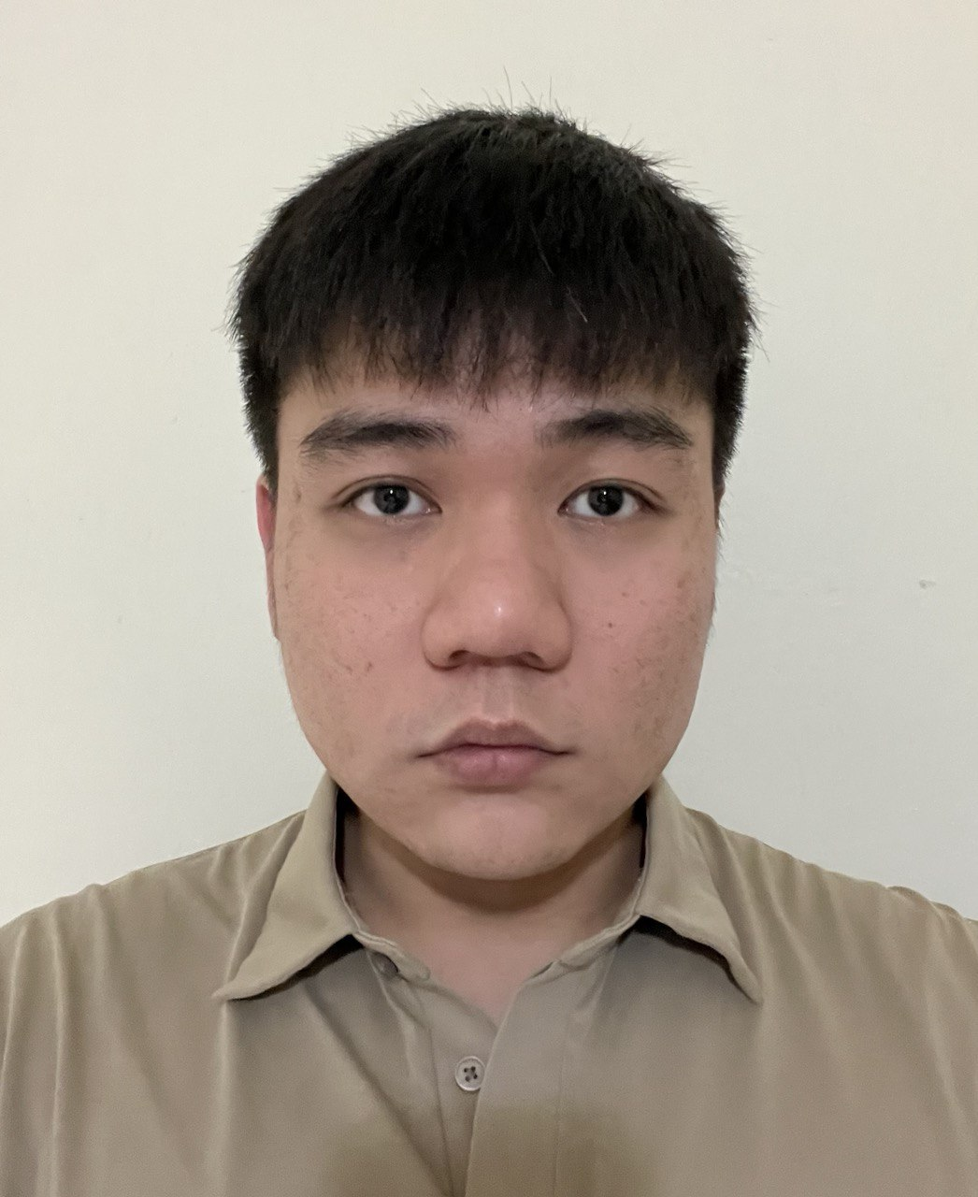
Meet the Team
Ming Han
Backend Developer
Mu Rong
Database Developer
Crystal
Frontend Developer
Chi Hian
Test Developer
Jun Koon
Business Development

Slide 3



Problem
Difficulty contacting renters and agents
Inability to get a view of the neighbouring area
Lack of comprehensive info on neighbourhoods
These are the main problems rentees currently face that we aim to solve through our web app

Slide 4
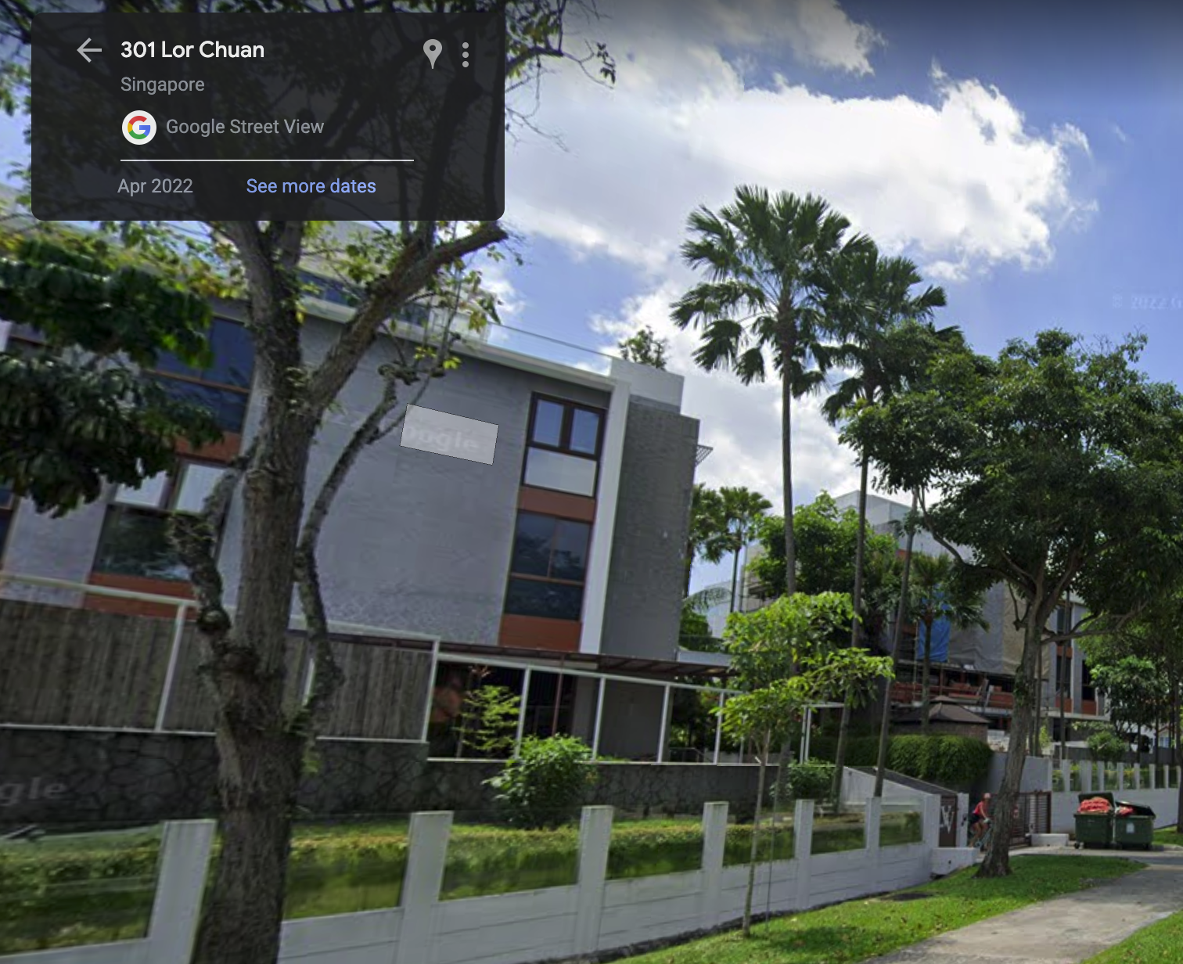
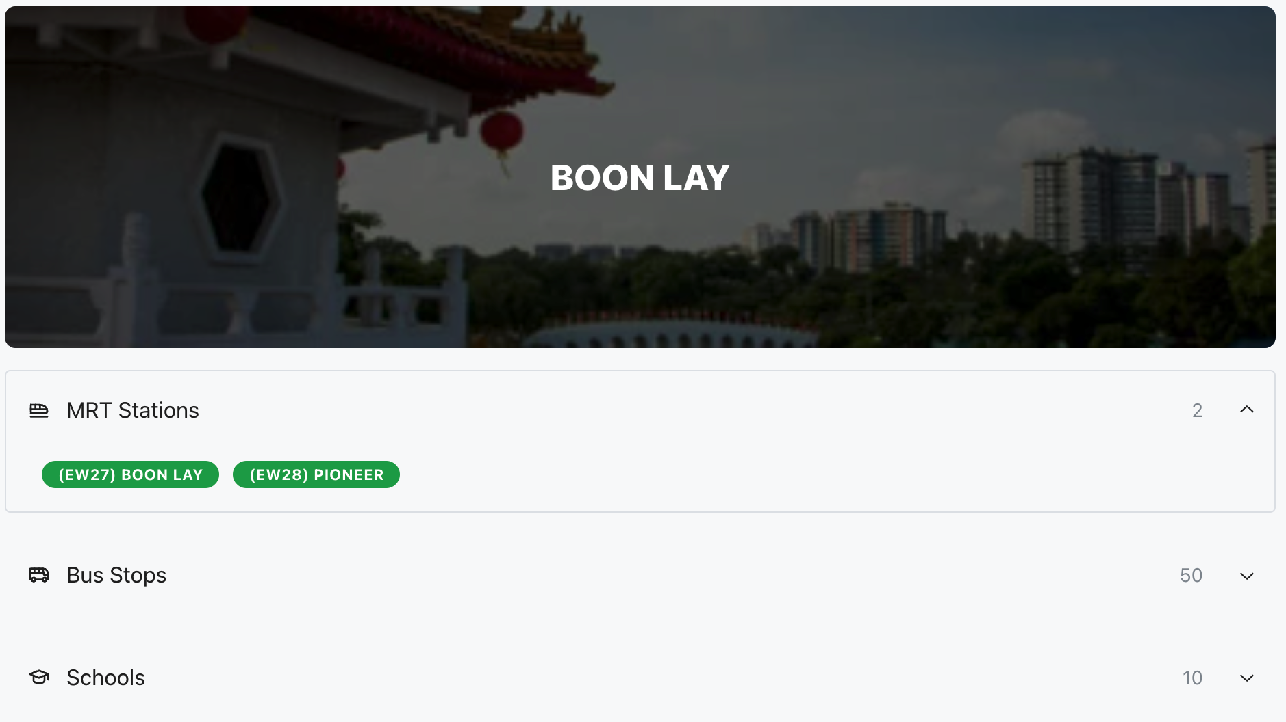

Our Solution
Allow users to call/WhatsApp agents and renters at the click of a button
Providing interactive street view of the property on the website
Allow users to explore different neighborhoods with elaborations on amenities available
Through these features and many others, we aim to solve the 3 main problems that rentees face.

Slide 5
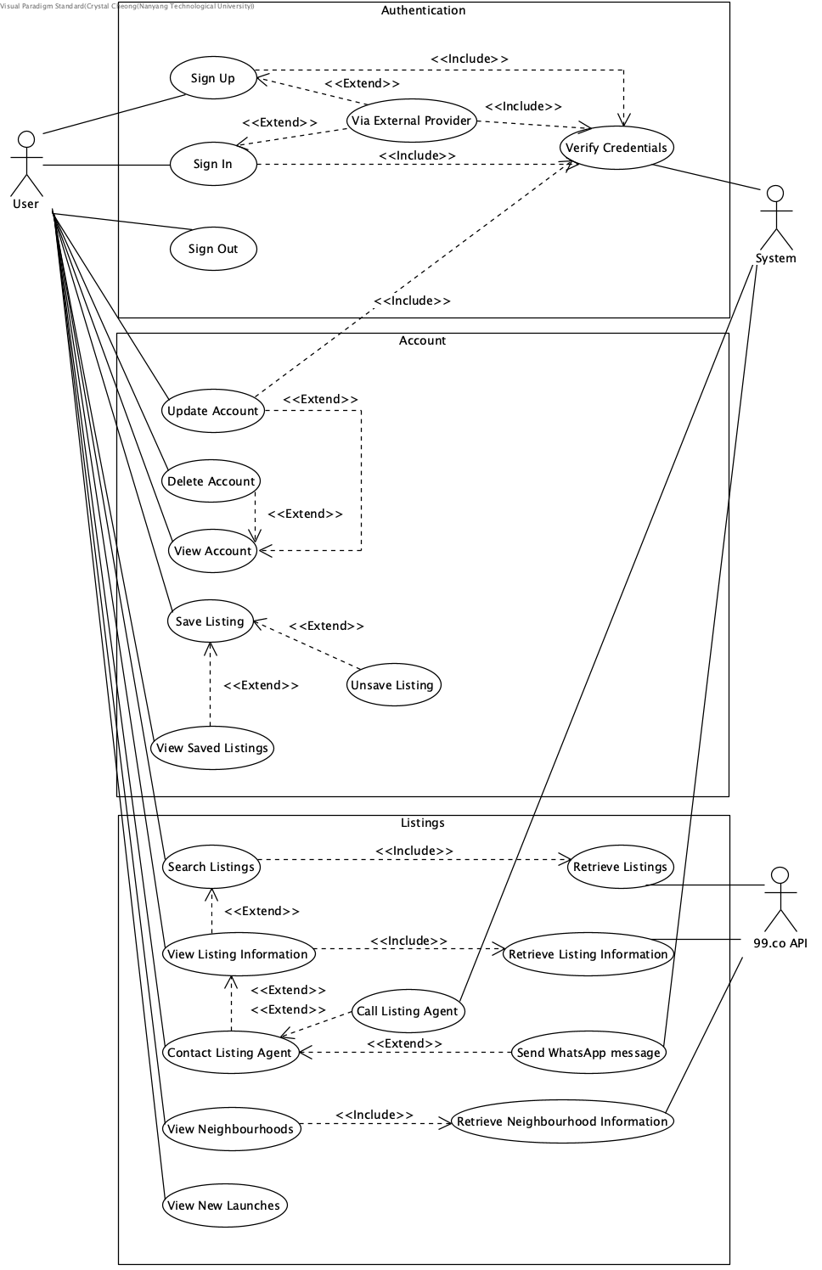
Use Case Diagram

Slide 6
Target Audience
Rentee
Broke college student that is looking to rent a room
Buyer
Newly wed looking to buy a house to settle down
Renter
Renter that wants to analyse the market for homes around his area

Slide 7
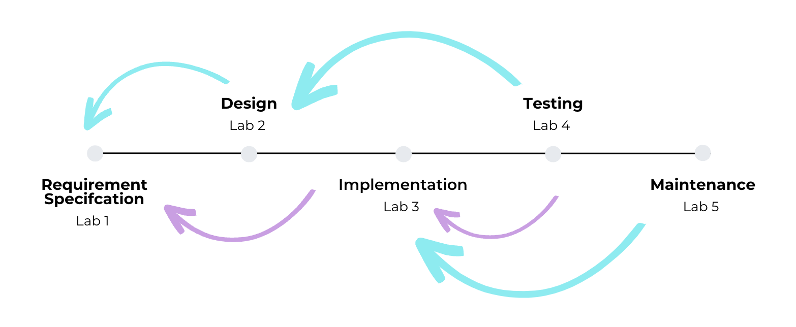
SDLC Activities

Slide 8
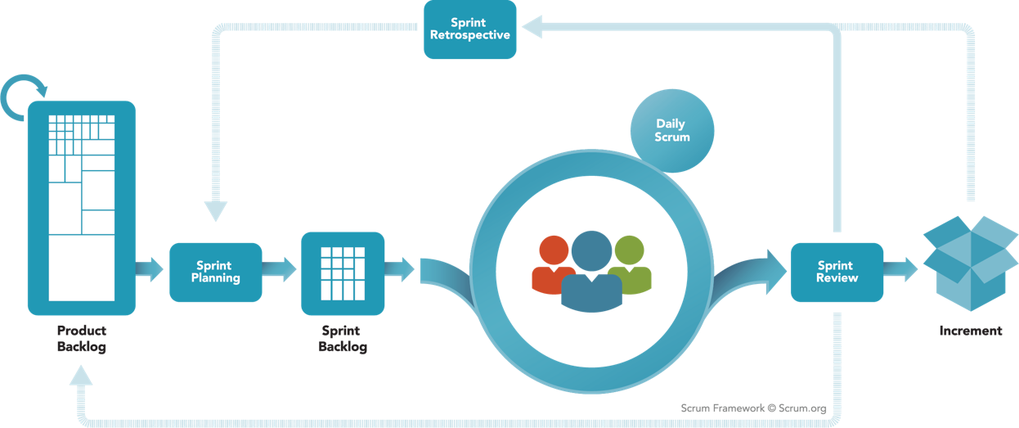
Project Management Philosophy
Agile Development Framework
Adapted the scrum methodology to facilitate the development of the project
Weekly and iterative stand-ups to measure progress and give feedback
Sprint Planning and review

Slide 9
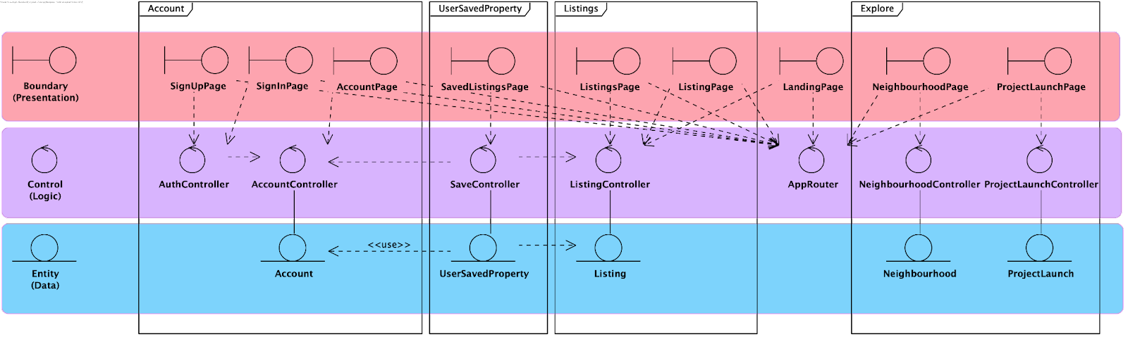
System Architecture

Slide 10
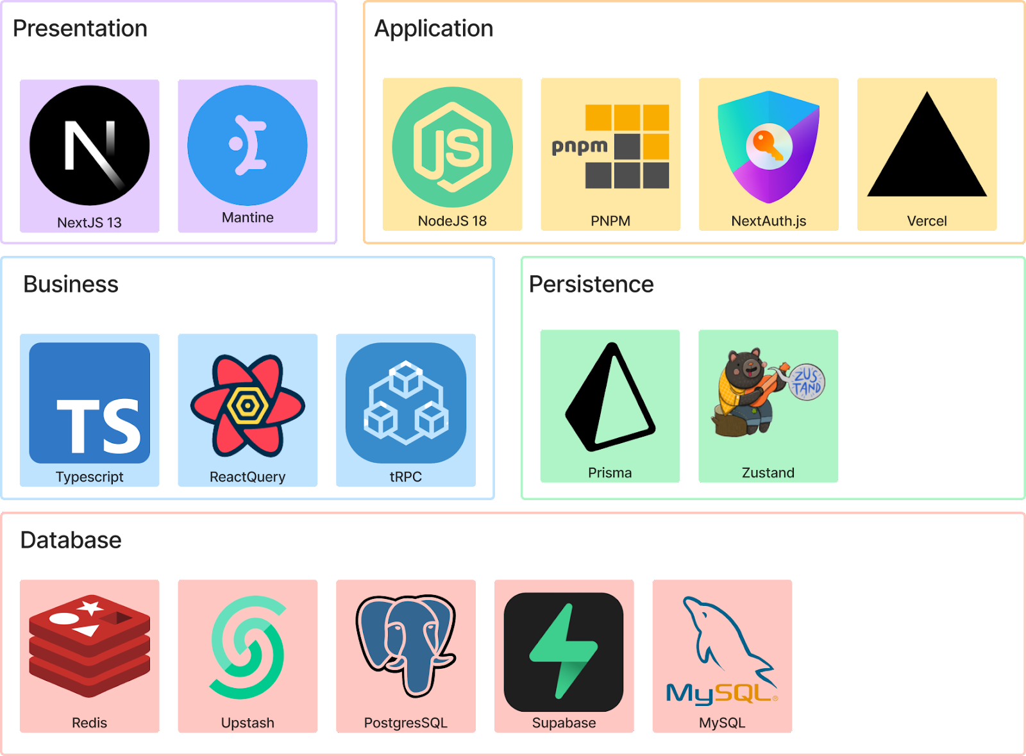
System Architecture

Slide 11
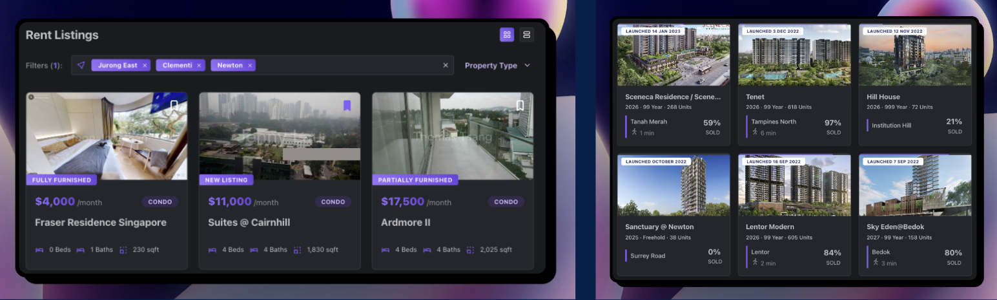
Features Overview
Search listings by property type and location
Save your favourite listings and view them at a glance
Explore neighbourhoods and latest condo launches

Slide 12



Software Practices
Small Increments
Pair Programming
Code Readability
Adding functions incrementally and testing along the way
Coding together and constantly checking each other’s work
Maintaining code readability to find bugs and errors easily

Slide 13
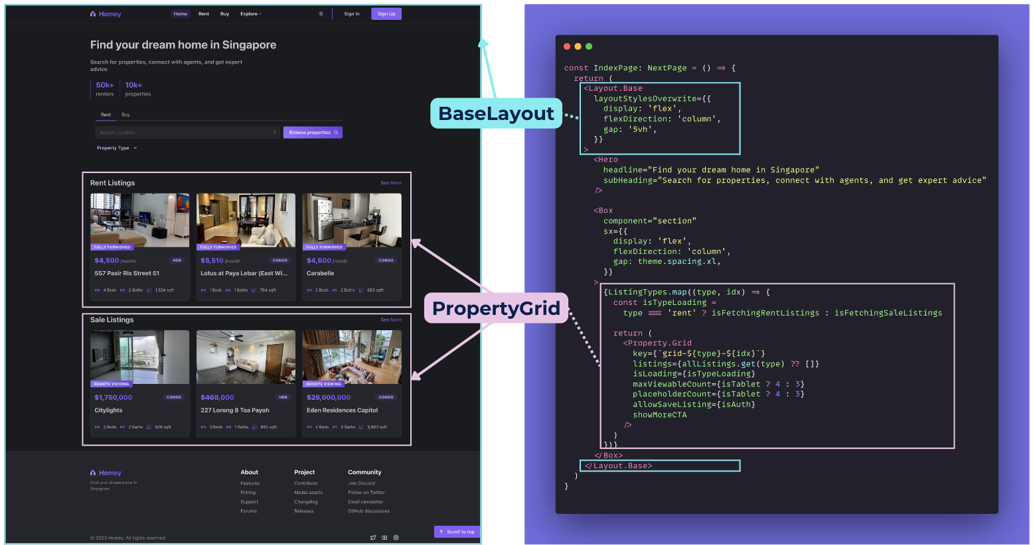
Reusability and Modularity

Slide 14
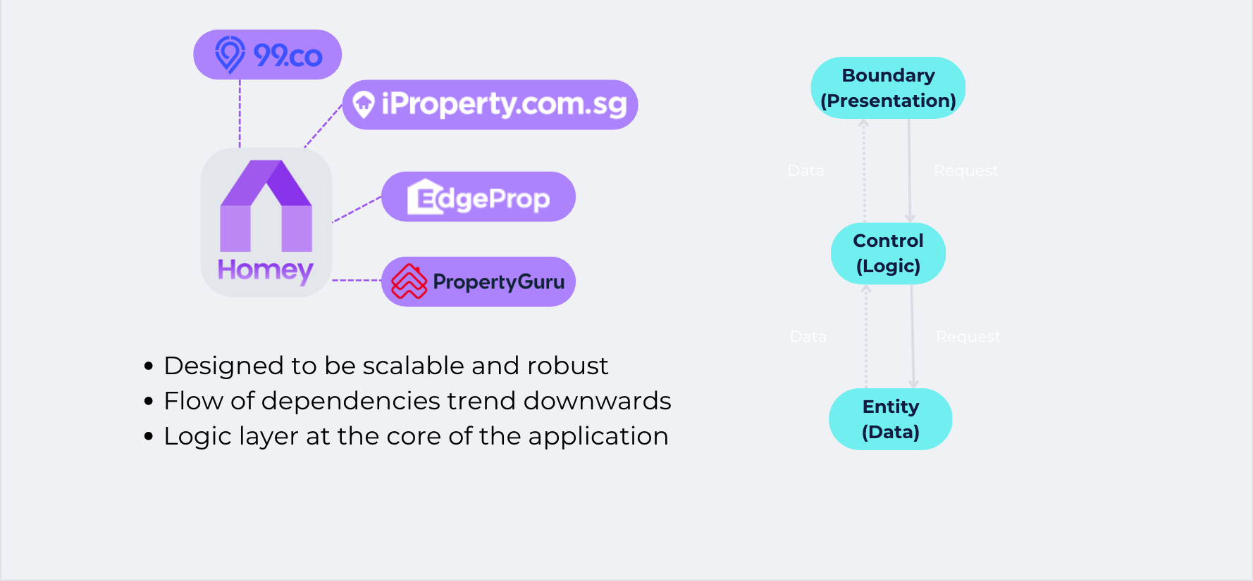
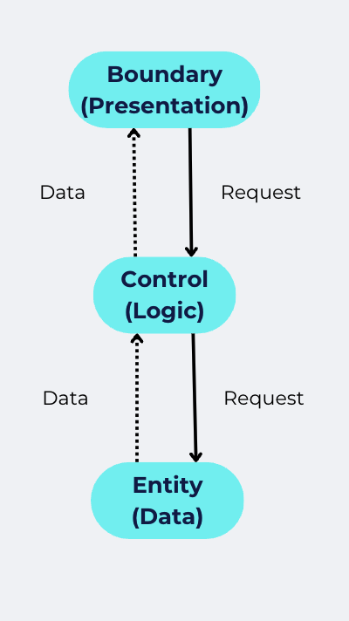
Extensibility

Slide 15
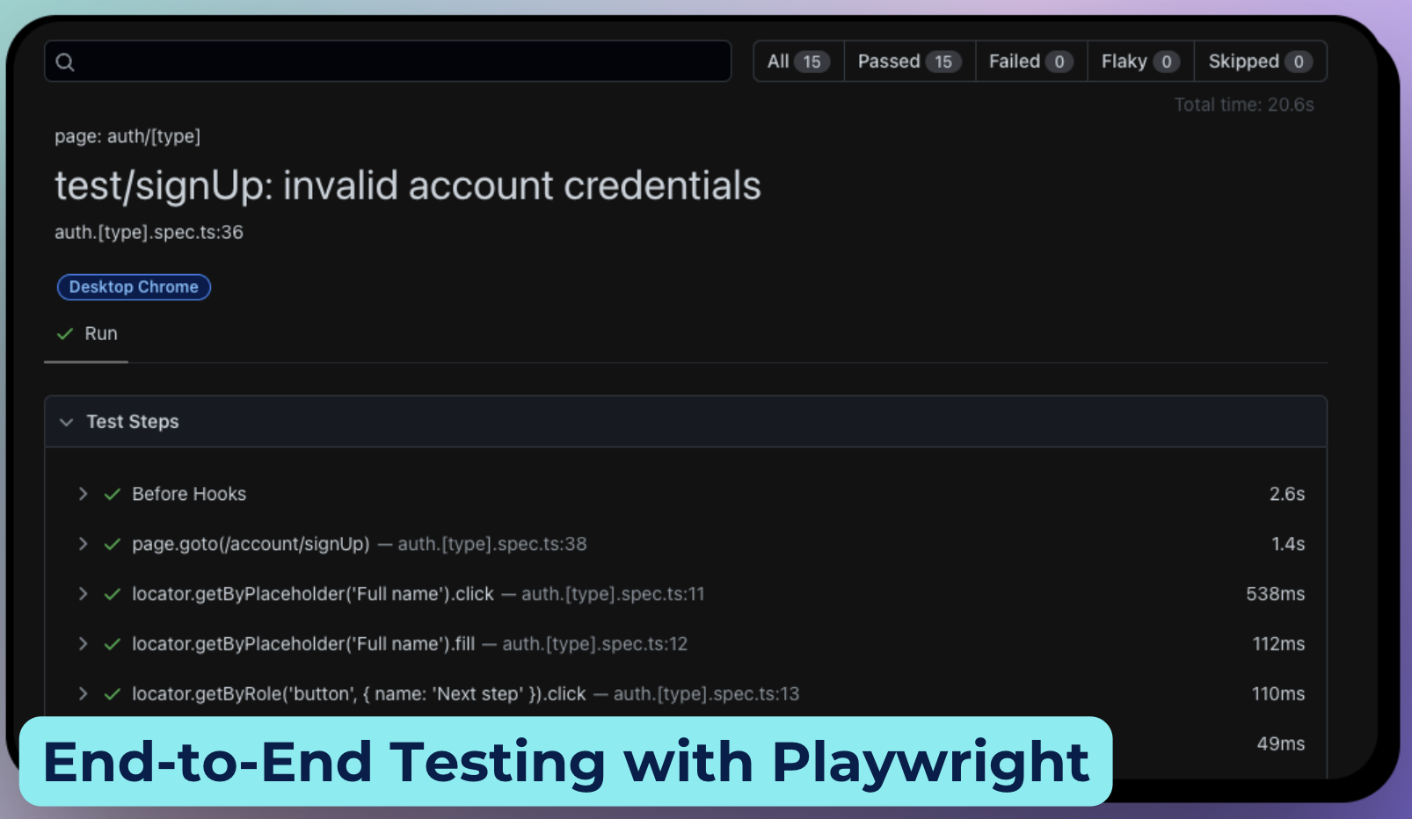
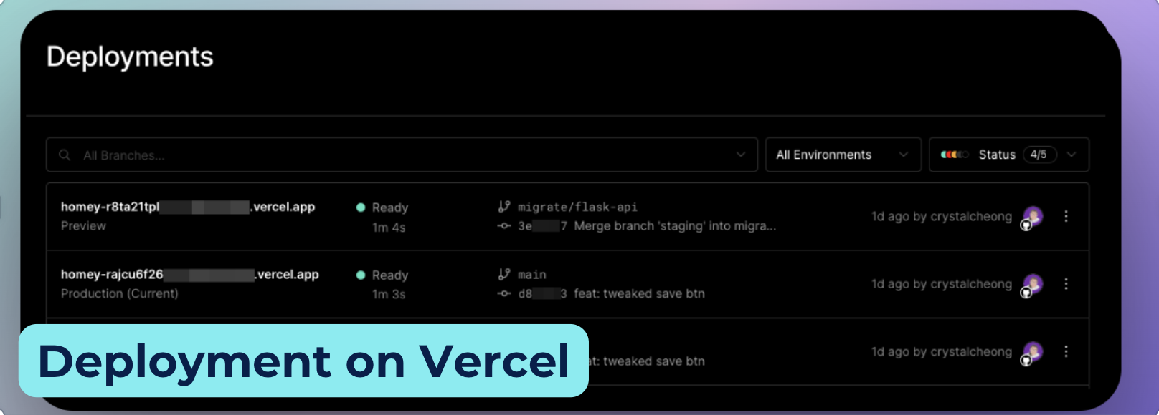
Continuous Integration
Faster development with reduced risks
Shorter review time
Version control and branching
Better code quality & faster bug fixes
Tools Used
Automated E2E Testing: Playwright
Deployment: Vercel
Code Formatter: ESLint, Prettier
Version Control: Git, Github

Slide 16
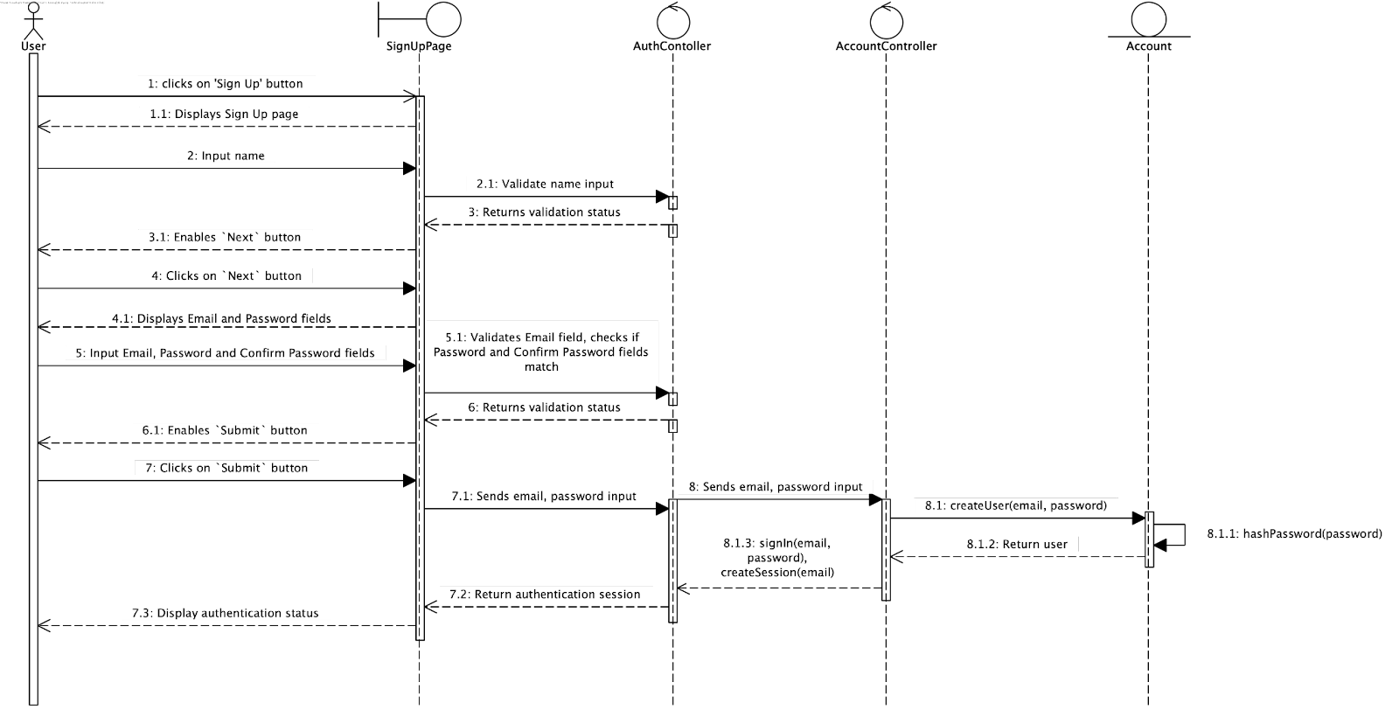
Traceability and Testing (Create User)

Slide 17
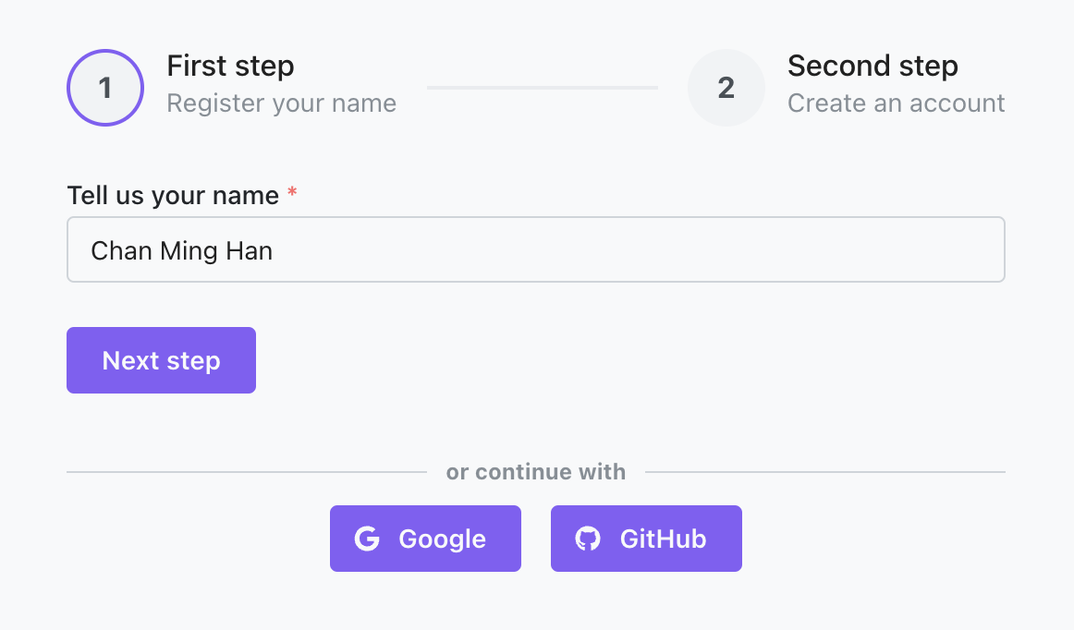
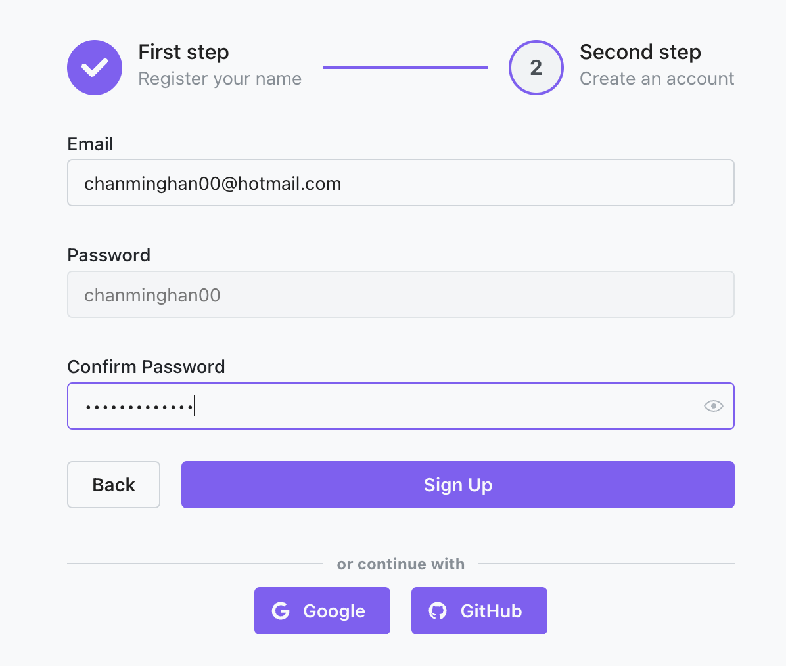
Traceability and Testing (Create User)
Frontend Form

Slide 18
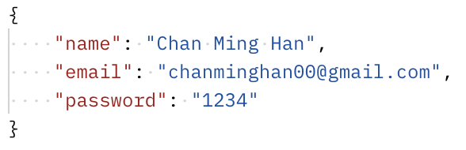
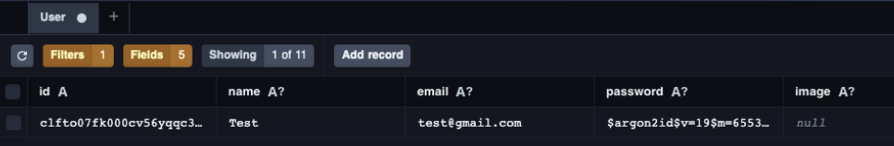
Traceability and Testing (Create User)
json-ified Output
Password salt-hashing with Argon2

Slide 19


Traceability and Testing (Create User)
Backend Handler
Create new user at the backend

Slide 20
Traceability and Testing (Create User)
Test Id | Scenario | Expected Output | Actual Output
1 | Name field is empty or invalid | System prevents moving on to the next step | System prevents moving on to the next step
2 | Register with valid name, email and password | The system displays the main page for user to continue the operation | The system displays the main page for user to continue the operation
3 | Register with existing account email | The system prompts the user that user already exists | The system prompts the user that user already exists
4 | Register with invalid name | The system prompts the user of invalid credentials | The system prompts the user of invalid credentials
5 | Register with mismatch password | The system prompts the user of mismatch credentials | The system prompts the user of mismatch credentials
6 | Register with invalid email | The system prompts the user of invalid credentials | The system prompts the user of invalid credentials
7 | Email or password field is empty | System does not allow clicking of ‘Sign Up’ button | System does not allow clicking of ‘Sign Up’ button

Slide 21
Traceability and Testing (Create User)
Name | Email | Password | Confirm Password | Expected Output | Actual Output
123 | - | - | - | Error: Invalid Name | Error: Invalid Name
(Empty) | - | - | - | Unable to click on object ‘Next step’’ | Unable to click on object ‘Next step’
testtwo | test2@gmail.com | test | test | The system displays the main page for user to continue the operation | The system displays the main page for user to continue the operation
test | test@gmail.com | test | test | Error: Sign Up Failed User already exists | Error: Sign Up Failed User already exists
testfour | test4@gmail.com | test | testing | Error: Passwords do not match | Error: Passwords do not match
testfive | test5@.com | (Empty) | (Empty) | Error: Invalid Email | Error: Invalid Email
testfive | (Empty) | test | test | Unable to click on object ‘Sign Up” | Unable to click on object ‘Sign Up’
testfive | test5@gmail.com | (Empty) | (Empty) | Unable to click on object ‘Sign Up” | Unable to click on object ‘Sign Up”

Slide 22
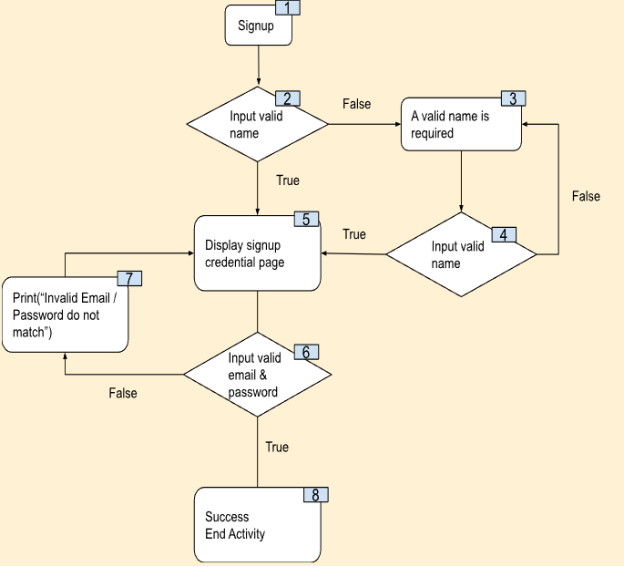
Traceability and Testing (Create User)
Test Cases | Expected Basis Path | Actual Basis Path
testtwo -> test2@gmail.com | 1, 2, 5, 6, 8 | 1, 2, 5, 6, 8
123 -> testthree -> test3@gmail.com | 1, 2, 3, 4, 5, 6, 8 | 1, 2, 3, 4, 5, 6, 8
123 -> 456 -> testfour -> test4@gmail.com | 1, 2, 3, 4, 3, 4, 5, 6, 8 | 1, 2, 3, 4, 3, 4, 5, 6, 8
testfive -> test5@.com -> test5@gmail.com | 1, 2, 5, 6, 7, 5, 6, 8 | 1, 2, 5, 6, 7, 5, 6, 8
Cyclomatic Complexity = 4

Slide 23


Homey
Expansion into SEA
Concrete plans to proliferate the Singapore homeowner and rental market
Further expansion into the APAC and SEA region
Increasing partnerships
Collaboration with local rental companies such as ERA, with plans to include fringe firms in future
Homey aims to become the one-stop solution for all property needs

Slide 24

Thank you!
Chan Ming Han
Crystal Cheong
Ng Mu Rong
Cheong Chi Hian
Ang Jun Koon
https://homey-sg.vercel.app/

